Slide 1

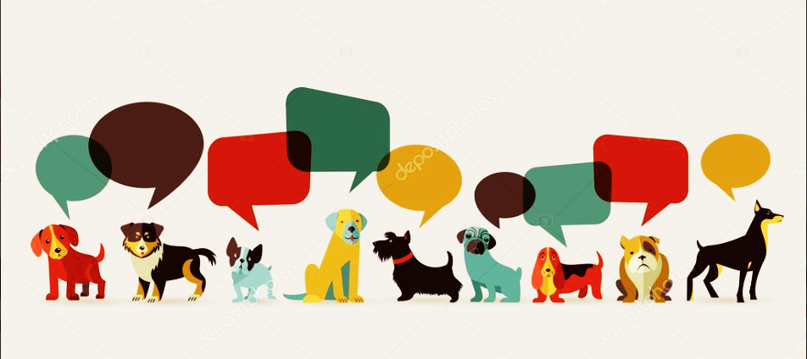
DOGGIEDEX
NICOLE
JOHN
JIMMY
BRIAN
GISELLE
KARL

Slide 2
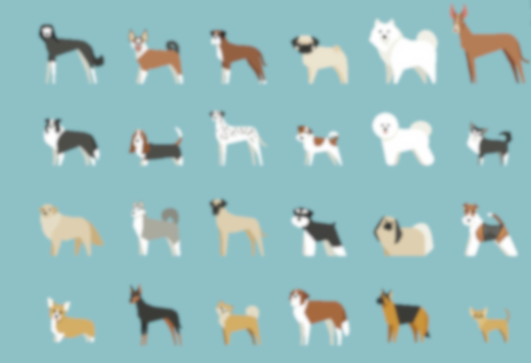
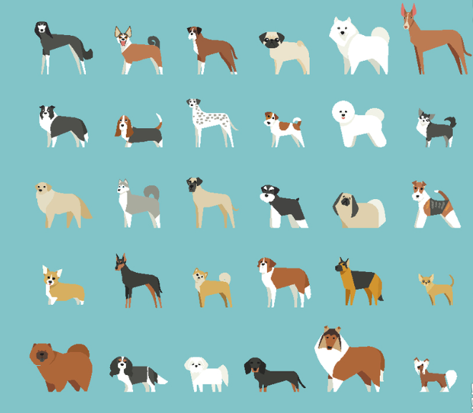
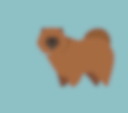



What Is DOGGIEDEX ?
You walk down the street and run into the cutest doggie and all you want to do is hold him and pet him. Now, you want to get the same dog at home, but oh no.. You don’t know the breed...
Don’t worry DOGGIEDEX has your back.
All you have to do is take a picture with him, and upload the picture!
DOGGIEDEX will do the magic and tell you the answer!

Slide 3
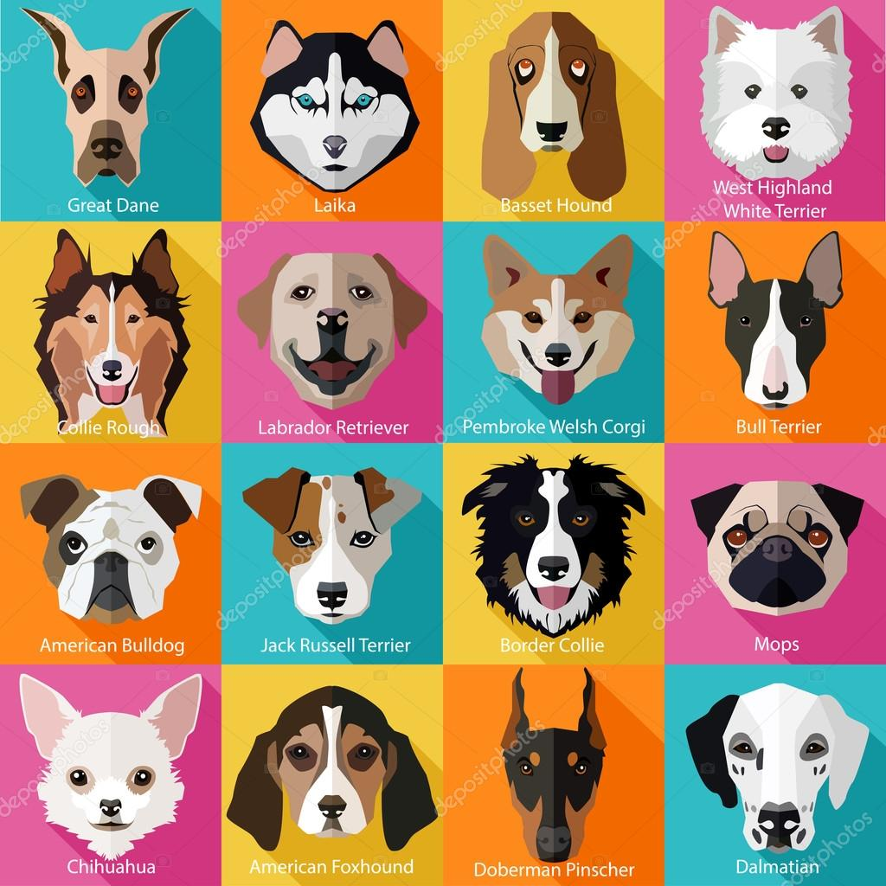
Main Idea
To have an image recognition software running on a website.
Build a search function that will allow users to upload their desired images
Recognition software will search through the database and will prompt similar results.
Results will be as follow: It will show specific breed, image, the percentage of accuracy recognizing the breed, as well as its label.

Slide 4

The Tools We Used:
TensorFlow
Keras
Scikit Learn
NUMPY
RESTful API
Bing API
Html, CSS, JavaScript & Bootstrap

Slide 5
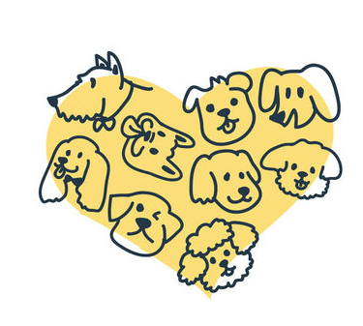
The Data Set We Found:
Data Set from Stanford University
Bing API
Dogs breeds csv

Slide 6



